Slide 1

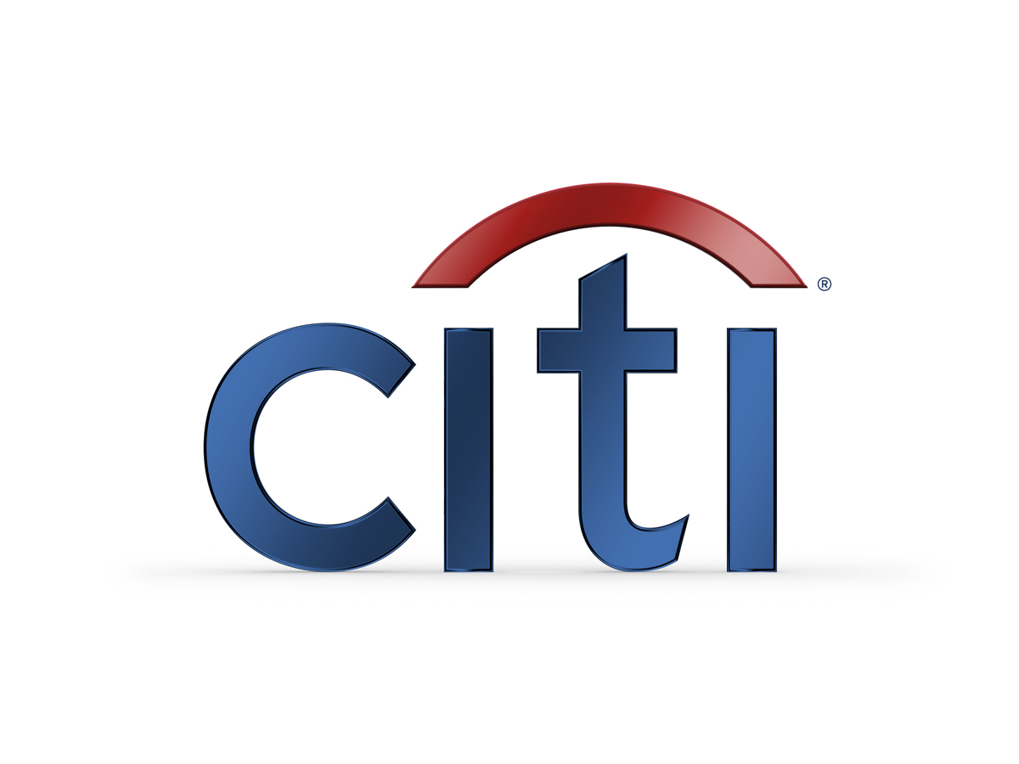
Overview Risk Capital Aggregation Process
October 14th, 2014
Confidential
© 2014 Citigroup. For Internal Use Only.

Slide 2
Table of Contents
Risk Capital Aggregation Process Overview
Risk Capital Governance Framework

Slide 3
Risk Capital Aggregation Process Overview
Firm-wide Risk Capital (RC) is aggregated quarterly by the Global Risk Reporting & Analysis (GRRA) group.
Quarterly RC is measured using month-end information at the middle month of the quarter for the majority of risk processes. For a few risk processes, the metric includes the average month-end information for each quarter (e.g.: iVAST)
RC Aggregation includes the following steps:
Collect RC submissions from various model/methodology owners (MPOs)
Review files received, and enrich and verify intra risk diversification (if needed)
Aggregate RC in DnA file and determine cross risk diversified RC
Report results

Slide 4
Risk Capital Production Process - Steps
Steps:
A. Collect submissions from MPOs
B. Review, enrich and intra-risk diversify
C. Aggregate DnA file and cross risk diversify
D. Report results
Retail Credit
Retail Credit
 | Standalone
 | Total Citi | Holdings | ICG | GCB | Corp/ Other | Intra-risk Div.
Retail Credit
Wholesale Credit
IDR
AA&I
Trading
OM
Ops
Cross Border
Total RC
Retail Credit
Wholesale Credit
Wholesale Credit
Wholesale Credit
IDR
IDR
IDR
ALM
ALM
ALM
PEARL Loading file
iVAST
iVAST
iVAST
AA&I
AA&I
AA&I
Risk Capital presentations
NHBC
NHBC
NHBC
OREO
OREO
DnA
DF*
OREO
XBDR
XBDR
* Diversification Factors (DF) are an output of the DnA model
XBDR
Original Submission
Operational
Operational
Operational
Intra risk diversified
Cross risk diversified

Slide 5
Risk Capital Production Process - Controls
Steps:
A. Collect submissions from MPOs
B. Review, enrich and intra-risk diversify
C. Aggregate DnA file and cross risk diversify
D. Report results
1
Retail Credit
2
Retail Credit
Retail Credit
 | Standalone
 | Total Citi | Holdings | ICG | GCB | Corp/ Other | Intra-risk Div.
Retail Credit
Wholesale Credit
IDR
AA&I
Trading
OM
Ops
Cross Border
Total RC
Wholesale Credit
Wholesale Credit
Wholesale Credit
IDR
IDR
IDR
4
ALM
ALM
ALM
PEARL Loading file
iVAST
iVAST
iVAST
AA&I
AA&I
AA&I
Risk Capital presentations
NHBC
NHBC
NHBC
3
OREO
OREO
DnA
DF*
OREO
Original Submission
XBDR
XBDR
* Diversification Factors (DF) are an output of the DnA model
XBDR
Intra risk diversified
Cross risk diversified
Operational
Operational
Operational
Controls:
1. Controls processes owned by MPOs
2. Compare vs Prior by Segment
3a. Maker Checker using mini DnA
3b. Compare vs prior
4. Detailed variance review for presentations to regulators and senior management

Slide 6
Risk Capital Governance
Firm-wide Risk Capital (RC) measurement and reporting is governed by the Risk Capital and Global Systematic Stress Testing Policy, owned by the Head of Franchise Risk Architecture (FRA).
The key elements of the Risk Capital and Global Systematic Stress Testing Policy are reviewed annually. (Latest review: August 2014).
Key decisions about Risk Capital, Global Systematic Stress Testing and Risk Appetite frameworks are overseen by the Risk Capital and Stress Testing Council (The Council), which includes representatives from Franchise Risk Architecture, Independent Risk and Treasury.
Methodology developers have the responsibility to ensure that approaches are well documented, reviewed at least annually, and updated to keep up to date with changes.
Any changes to Citi-wide Risk Capital models and methodologies must be approved by the Head of FRA in consultation with the Council.
Risk Capital governance is complemented by various forums including: RCAST Executive Committee, RCAST Working Groups, Risk Capital and Stress Testing Council, Methodology Working Groups, and other various meetings with Management, Regulators.

